Slide 1
LIBRARY NOTIFIER
Laxana N Tamke.
3014290
TY Bsc IT
HET’s CSCSIT, Mahad
Under the Guidance of Prof.Varsha Nikam
A.Y 2025-26

Slide 2

Introduction
The Library Notifier System is a web-based application developed to manage library operations efficiently.
It helps in maintaining records of books, students, and issued books in a structured manner.
The system automates tasks such as book issuing, returning, and tracking due dates.
It reduces manual work and improves accuracy in library management.
It reduces manual work and improves accuracy in library management.

Slide 3
Problem Statement
Existing library systems depend on manual processes, leading to inefficiency and human errors in maintaining records.
There is no real-time tracking of issued and returned books, making it difficult to monitor availability.
Absence of an automated notification system leads to poor communication and delayed actions.
Book inventory management becomes inaccurate due to improper updates and lack of synchronization.
Manual fine calculation is time-consuming and prone to miscalculations.
Overall, the manual approach reduces efficiency, increased workload, and affects the quality of library services.

Slide 4
Objective
To calculate fines automatically for late returns.
To develop a web-based system for efficient management of library operations.
To automate book issuing and returning processes to reduce manual work.
To ensure better organization and control over library resources.

Slide 5
Existing
System
• Students are not reminded about due dates, leading to overdue books.
• Searching for book or student records is slow and inefficient.
• The existing library system relies on manual record-keeping using registers or basic files.
• Book issuing and returning processes are handled manually, which is time-consuming.
• There is no proper real-time tracking of available and issued books.

Slide 6
Proposed
System
• The system is a web-based Library Notifier Application designed to automate library operations.
• It provides a centralized database to manage books, students, and transactions efficiently.
• Books can be easily added, updated, and managed through the system.
• Students’ details are stored and managed digitally for quick access.

Slide 7
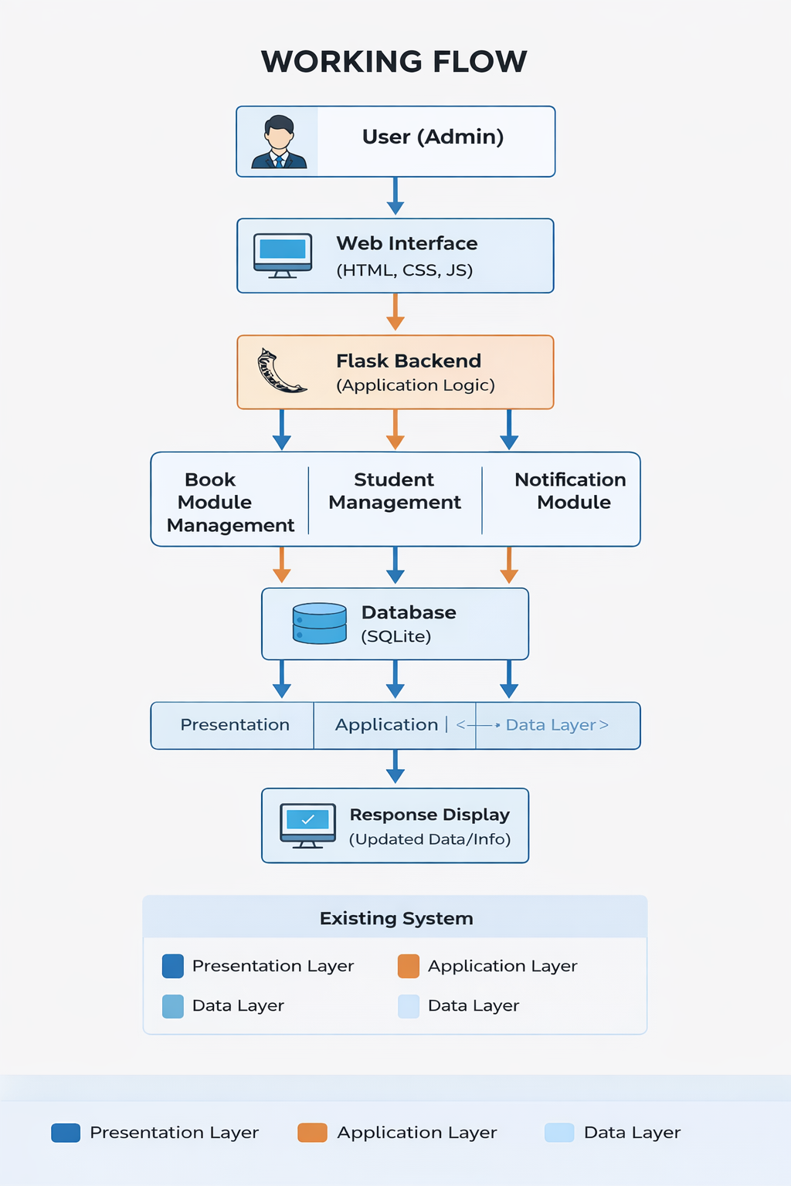
System Architecture
Presentation Layer (Frontend): Developed using HTML, CSS, and JavaScript. Provides the user interface for the administrator. Displays book records, issued books, notifications, and forms for input.
Application Layer (Backend): Developed using Python with the Flask framework. Handles business logic such as book issuing, returning, fine calculation, and notification generation. Processes user requests and communicates with the database.
Application Layer (Backend): Developed using Python with the Flask framework. Handles business logic such as book issuing, returning, fine calculation, and notification generation. Processes user requests and communicates with the database.

Slide 8
Methodology/Workflow
The Library Notifier Web Application follows a structured workflow to ensure efficient management of library operations. The methodology is designed to automate processes such as book management, issuing, returning, and notification generation.
Workflow Steps:
User Authentication
Book Management
Student Management
Book Issuing Process
Database Update
Book Return Process
Overdue Detection
Notification Generation
Result Display

Slide 9
Tools and Technologies
Backend : Python(flask)
Frontend : HTML,CSS
Database : SQL
Tool : VS Code

Slide 10
Database Design
Tables:
• Books Table
• Issued Books Table
• Students Table
• Admin (Login) Table
Fields:
• Book ID
• Title
• Author
• Quantity
• Issue ID
• Book ID (Foreign Key)
• Student Name
• Student Class
• Roll No
• Issue Date
• Return Date
• Returned Status
• Student ID
• Full Name
• Class
• Roll No
• Contact
• Email
• Admin ID
• Username
• Password

Slide 11
Implementation/Screenshot
• Folder Structure
• Database Tables (Books, Students, Issued Books)
• Login Page
• Dashboard (Total, Issued, Available Books Overview)
• Add Book Form
• Book List (Manage Books)
• Issue Book Form
• Issued Books List
• Return Book Function
• Notifications Page (Overdue & Fine)
• Student Management Form
• Running Project (Terminal + Browser Output)

Slide 12
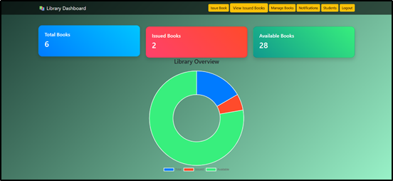
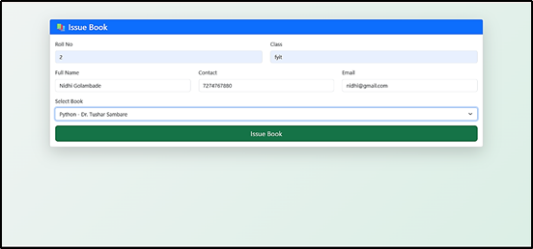
Result/Output

Slide 13
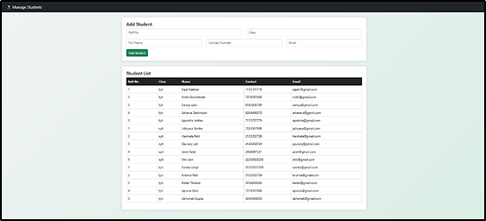
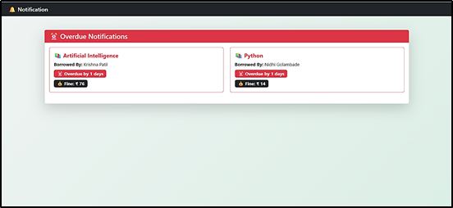

Slide 14
Advantages
• Improves accuracy and avoids human errors
• Saves time for librarians and users
• Provides real-time data and updates
• Simple and user-friendly interface
• Centralized data storage using database
• Enhances overall efficiency of library system

Slide 15
Limitations
• Requires computer system and basic technical knowledge
• Dependent on system availability (may stop if server crashes)
• Limited scalability for large libraries
• Data loss risk if database backup is not maintained

Slide 16
Future Scope
Multi-User Access
Mobile Application Development
Online Fine Payment
Advanced Search System
Online Book Reservation
Improved Security Features

Slide 17
Conclusion
The Library Notifier System simplifies library management by automating book issuing, returning, and overdue tracking. It improves efficiency, reduces manual errors, and provides a user-friendly solution for managing library operations effectively

Slide 18
References
• Python Official Documentation
• SQL Official Documentation
• W3Schools (Web Development Tutorials)
• GeeksforGeeks
• TutorialsPoint
• YouTube Tutorials
• Flask Official Documentation

